Slide 1
Chapter 24
TCP/IP

Slide 2
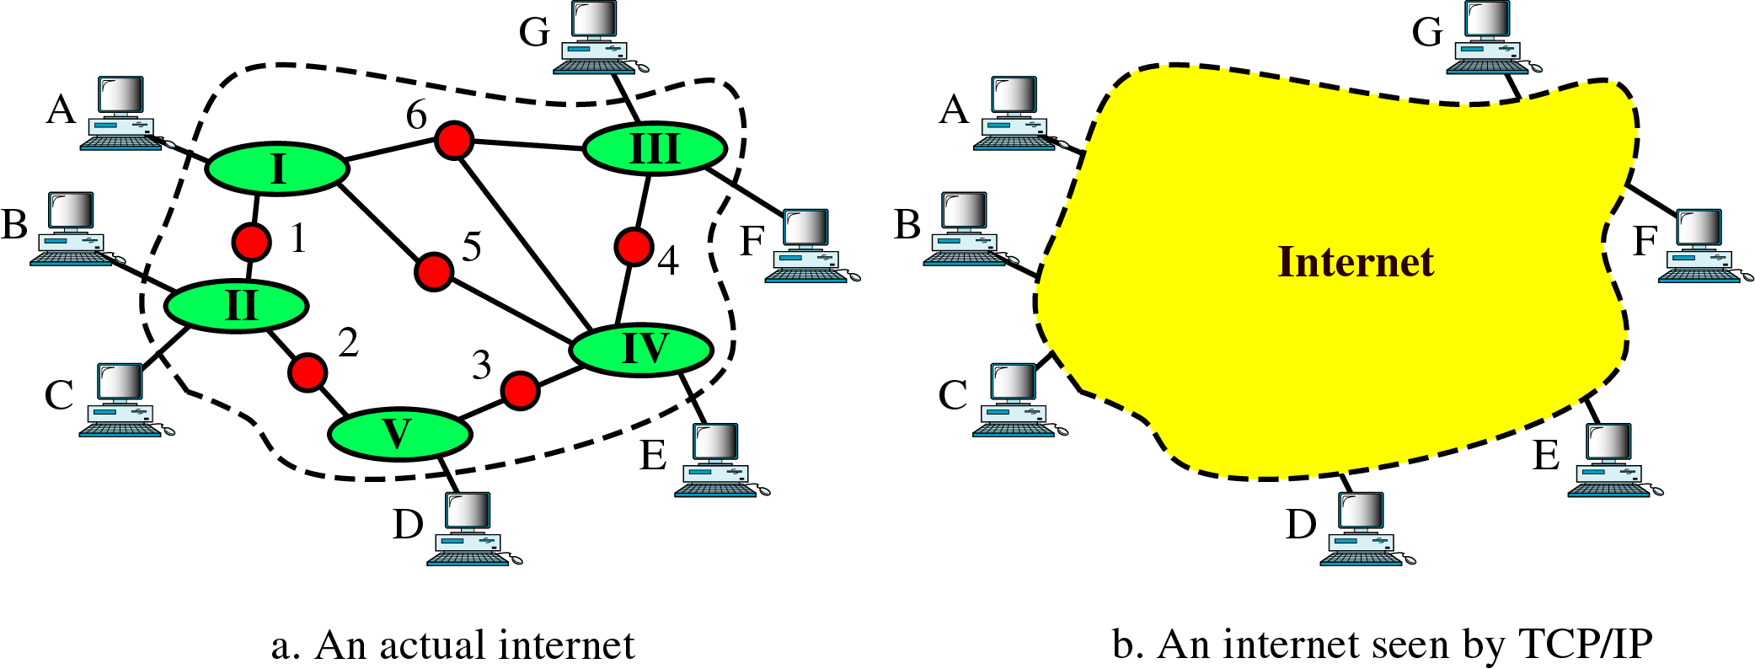
Figure 24-1
An Internet According to TCP/IP

Slide 3
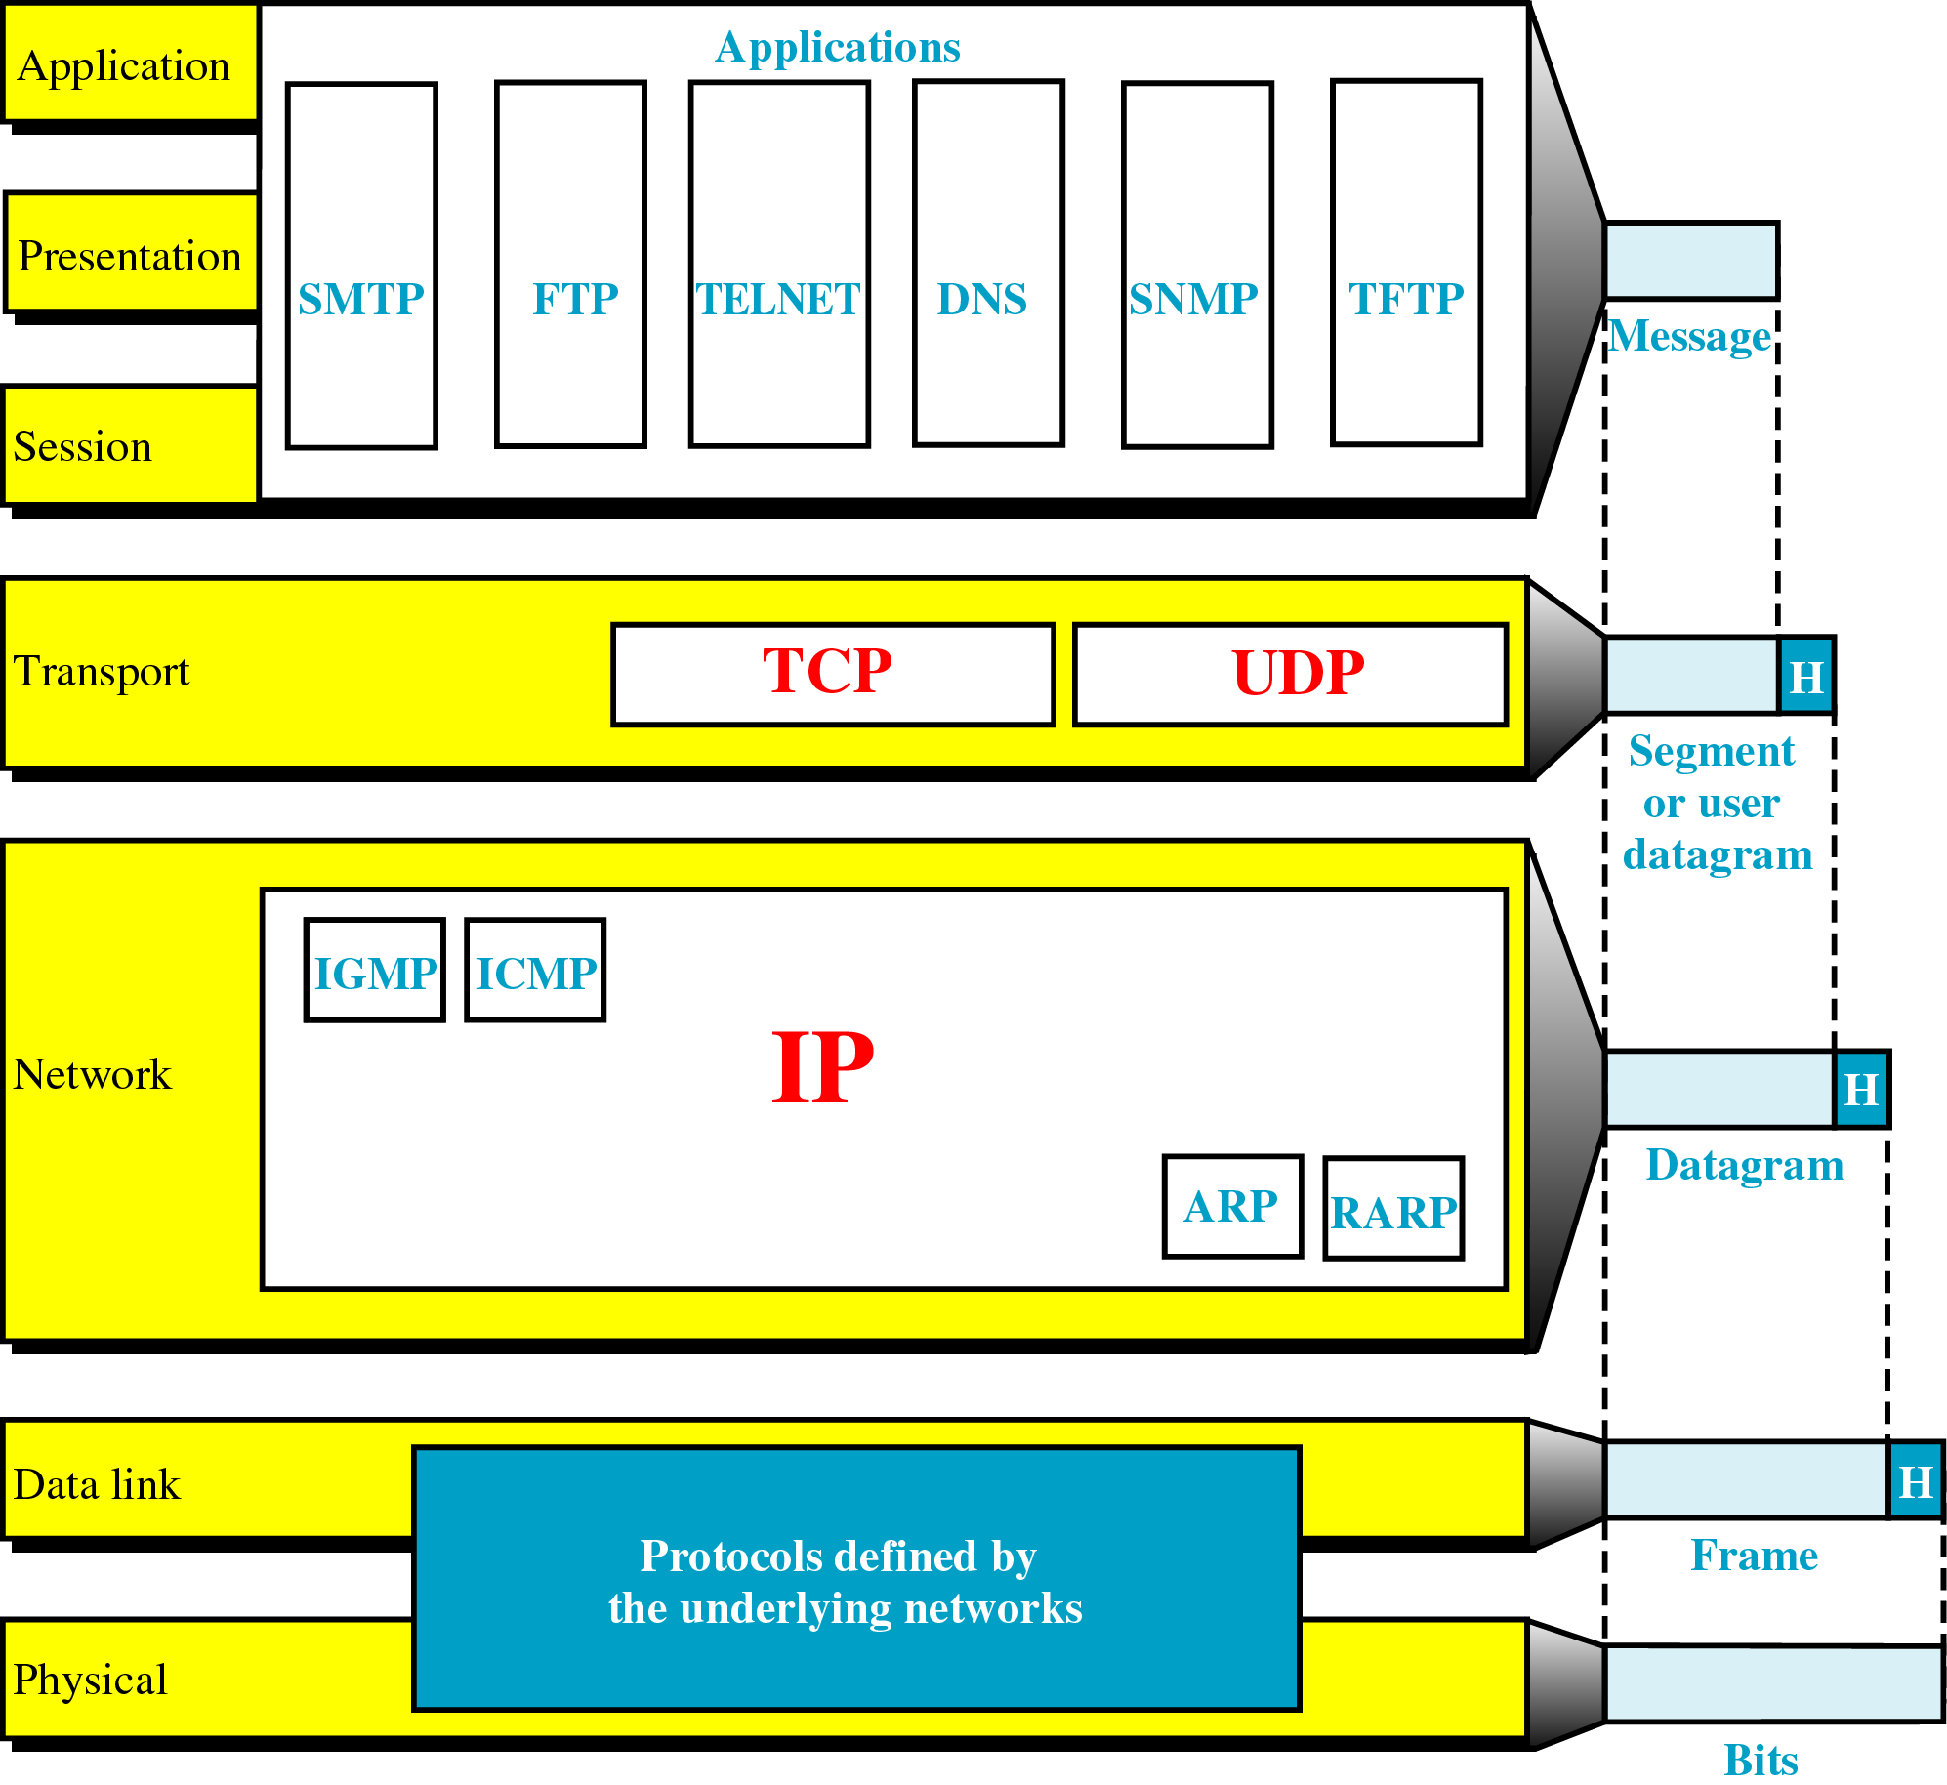
Figure 24-2
TCP/IP and the OSI Model

Slide 4
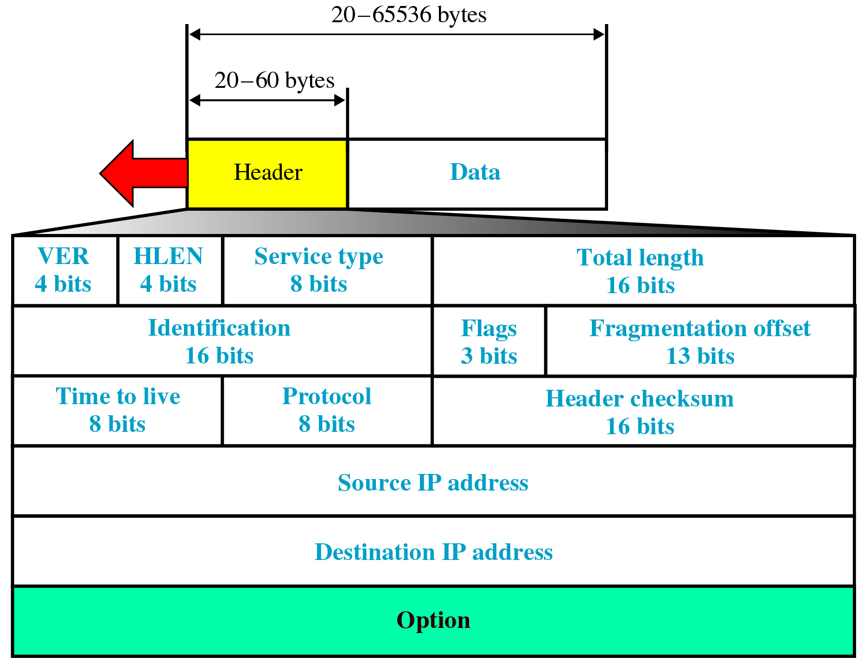
Figure 24-3
IP Datagram

Slide 5
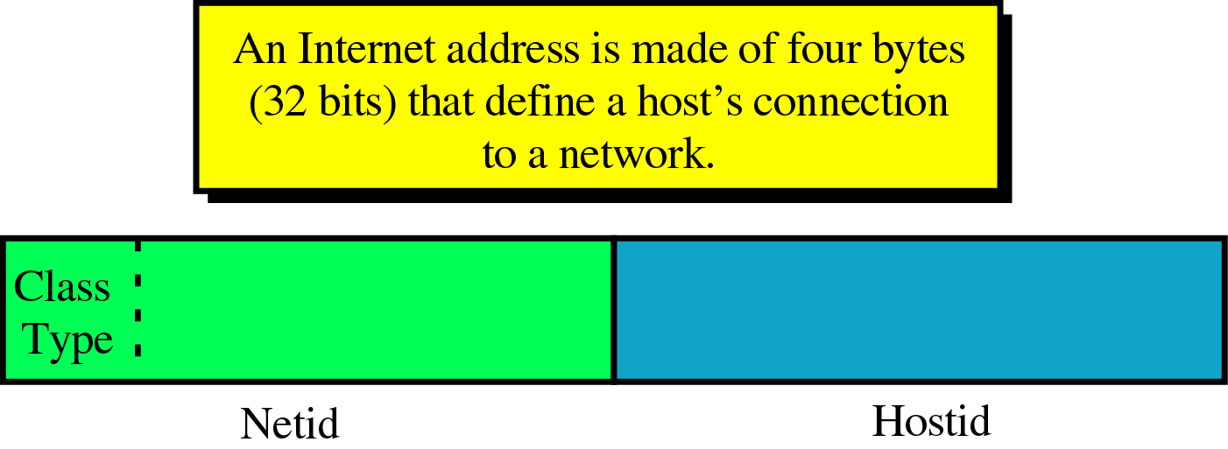
Figure 24-4
Internet Address

Slide 6
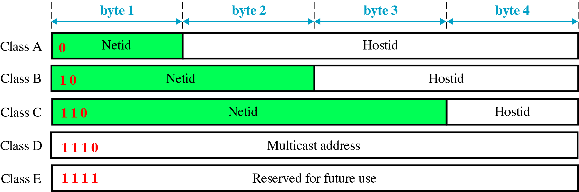
Figure 24-5
Internet Classes

Slide 7
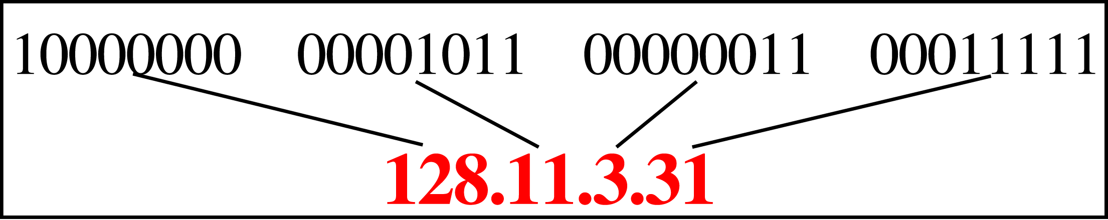
Figure 24-6
IP Addresses in Decimal Notation

Slide 8
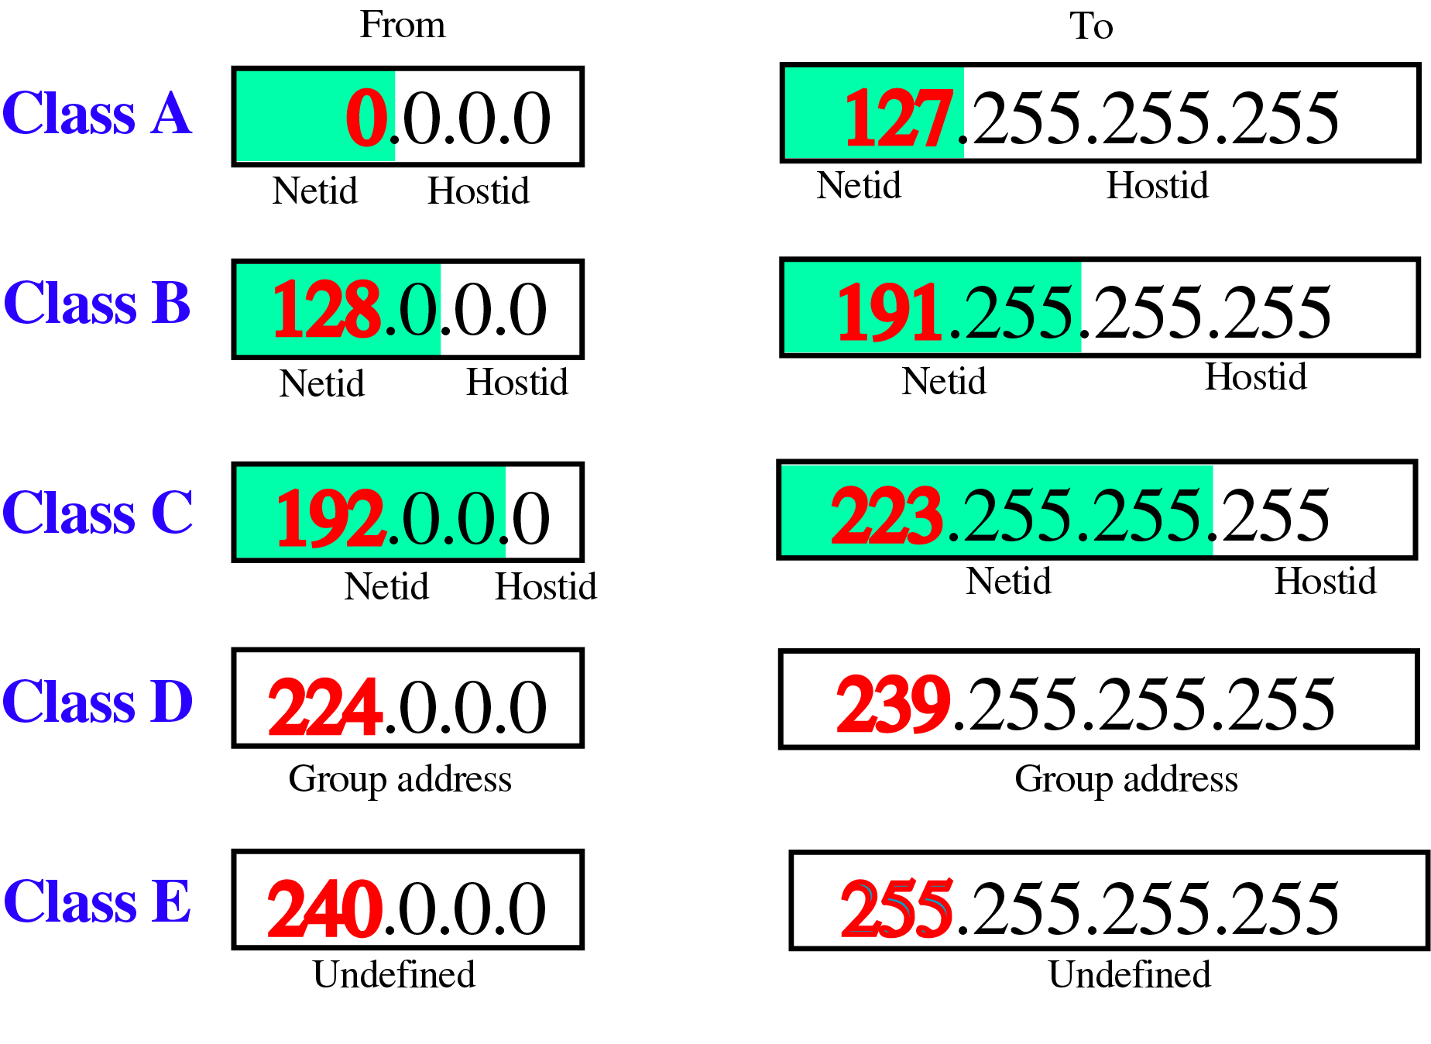
Figure 24-7
Class Ranges of Internet Addresses

Slide 9
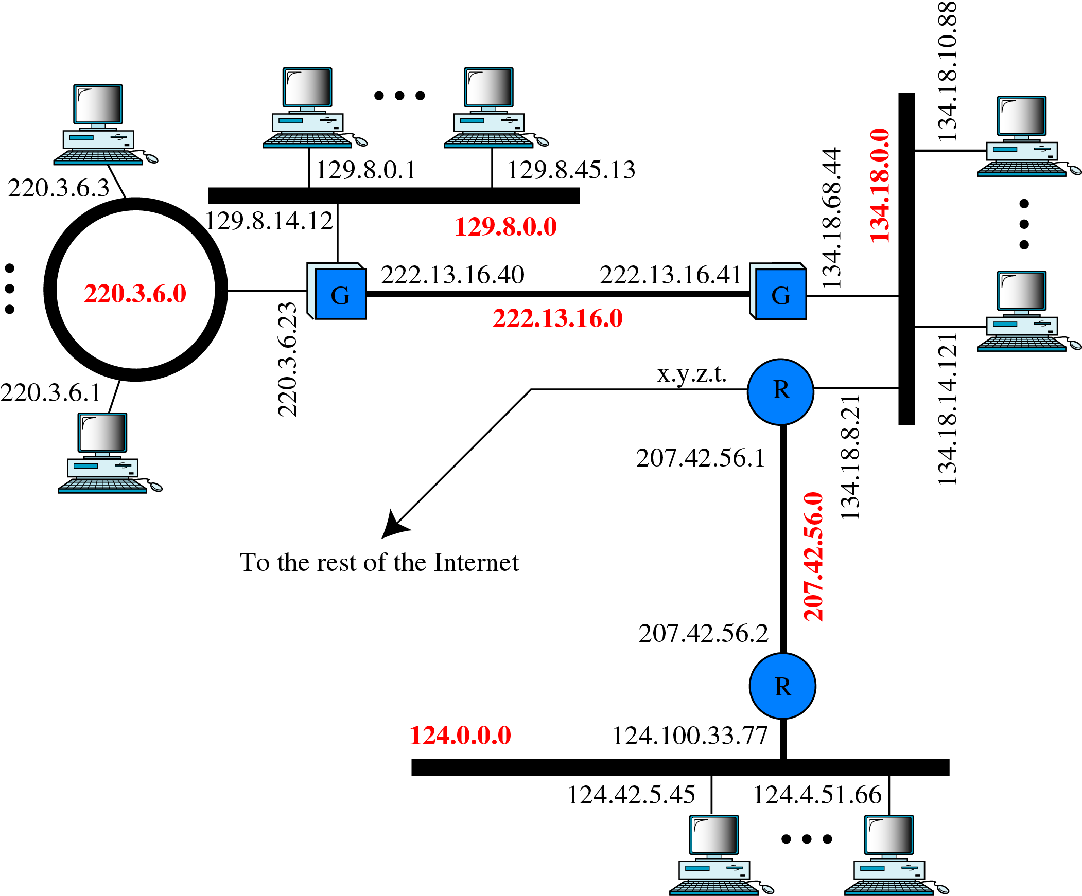
Figure 24-8
Network and Host Addresses

Slide 10
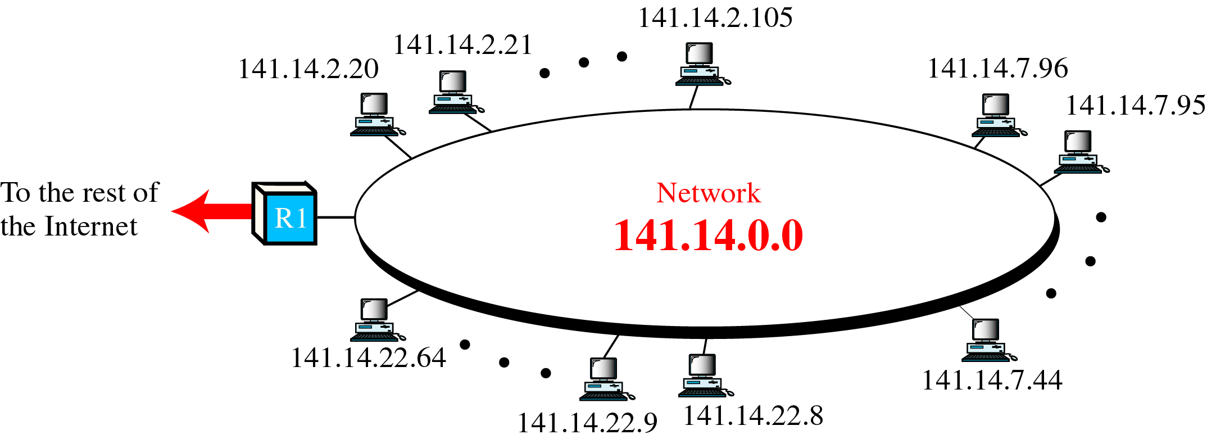
Figure 24-9
A Network with Two Levels of Hierarchy

Slide 11
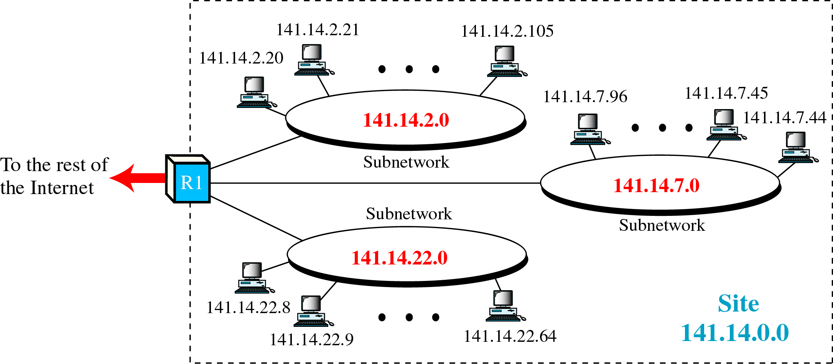
Figure 24-10
A Network with Three Levels of Hierarchy

Slide 12
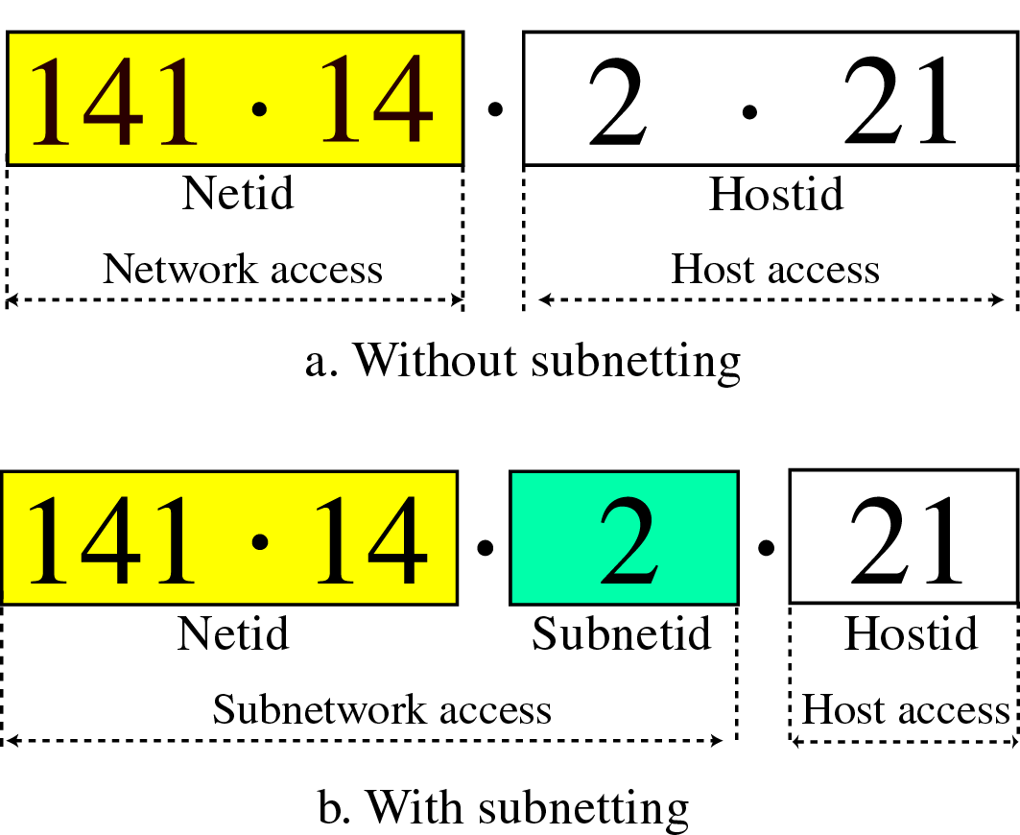
Figure 24-11
Addresses with and without Subnetting

Slide 13
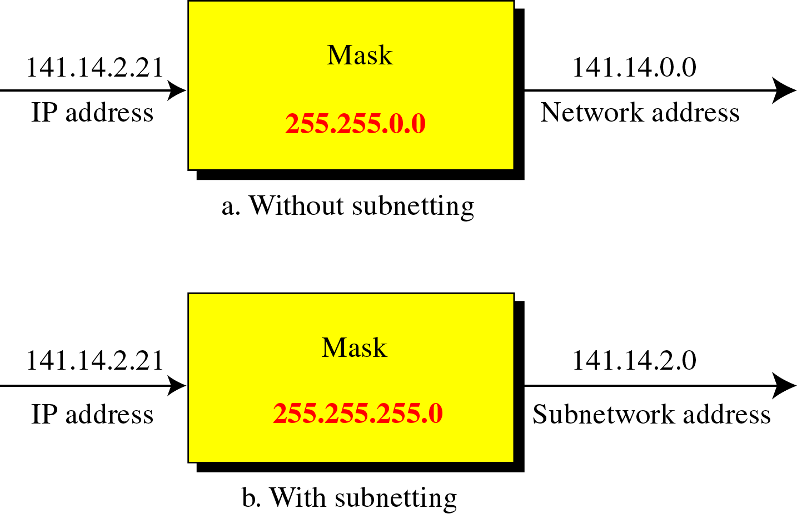
Figure 24-12
Masking

Slide 14
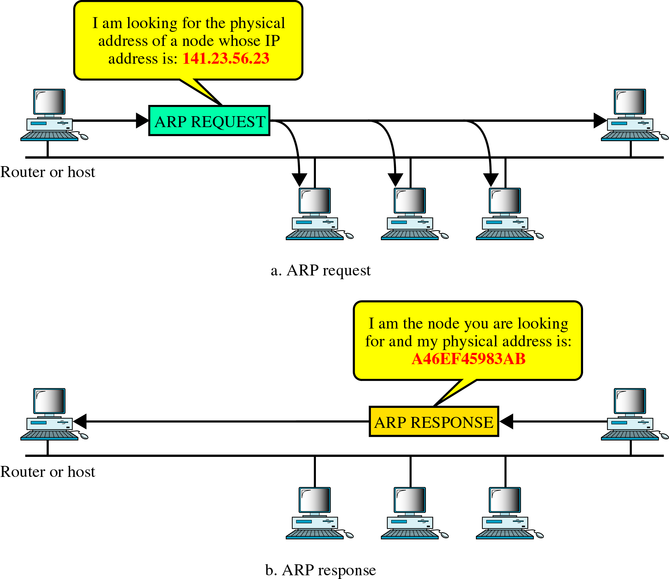
Figure 24-13
ARP

Slide 15
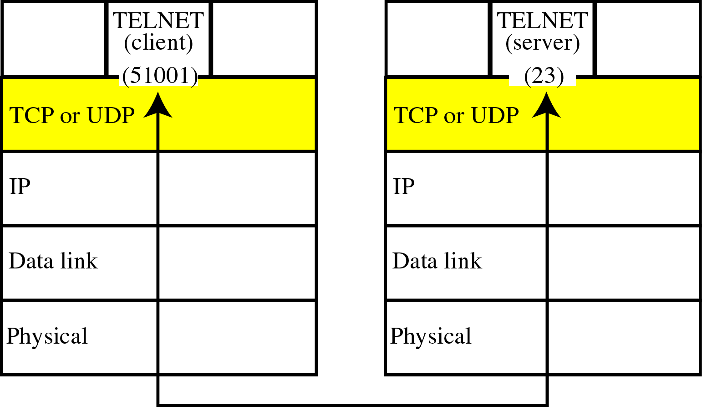
Figure 24-14
Port Addresses

Slide 16
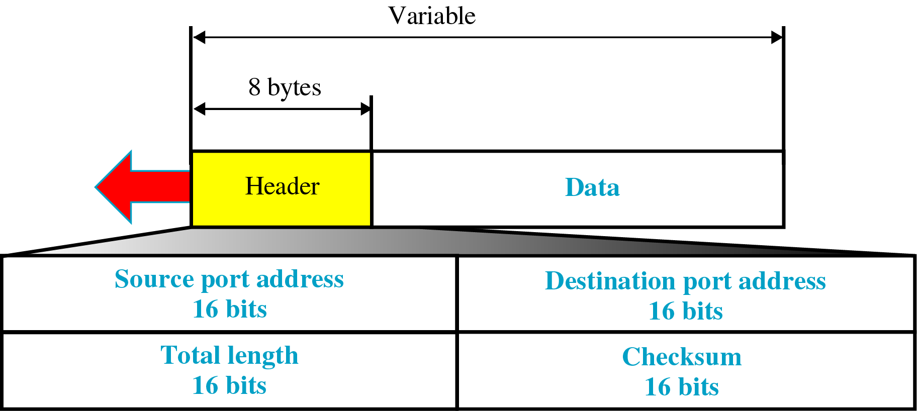
Figure 24-15
UDP Datagram Format

Slide 17
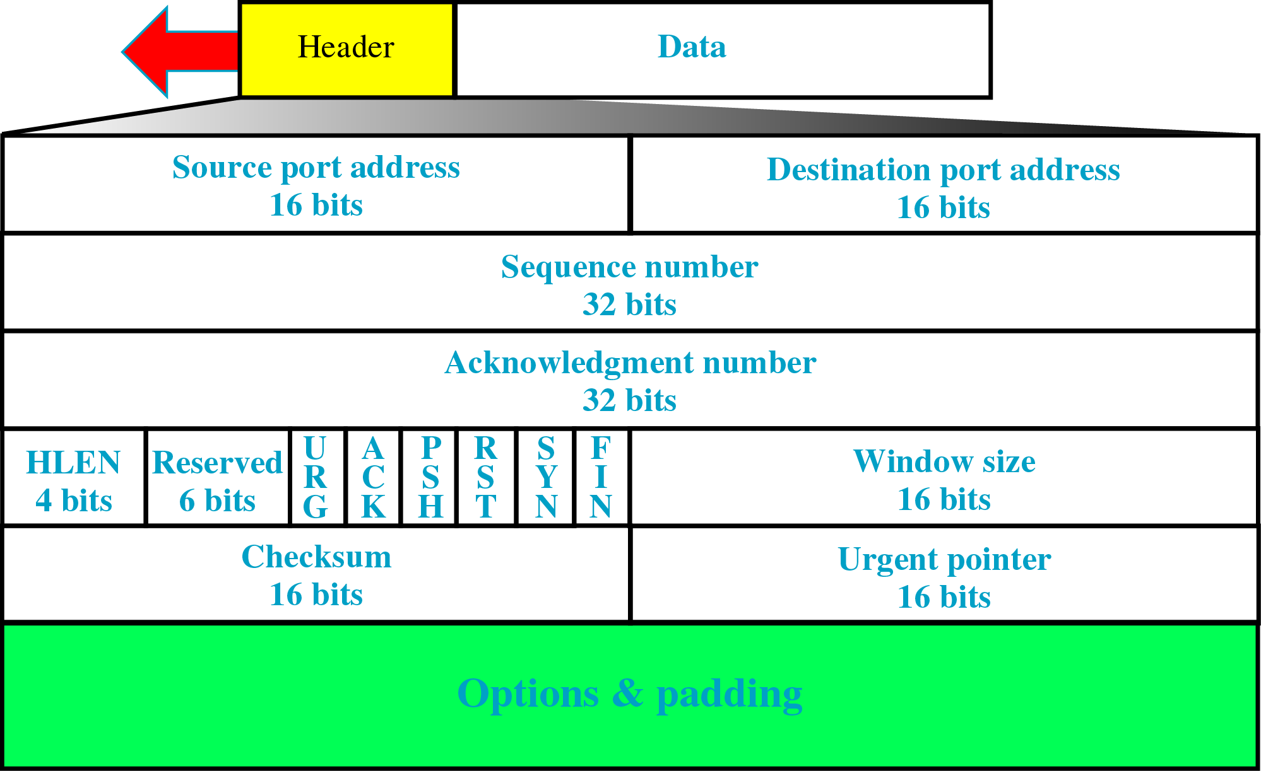
Figure 24-16
TCP Segment Format

